Slide 1
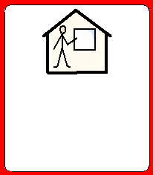
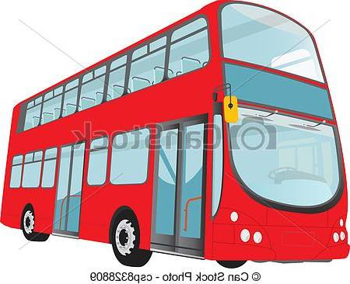
Tom’s journey to school.

Slide 2
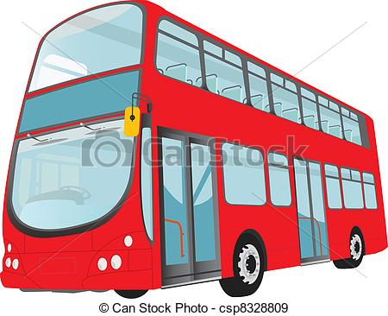
What do you need to remember to have with you to use the bus?

Slide 3
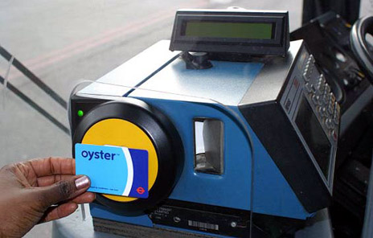
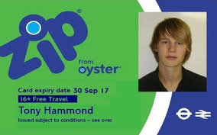
Oyster Zip photocard

Slide 4
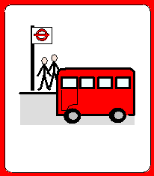
What’s the number of the bus you get from Highgate?

Slide 5
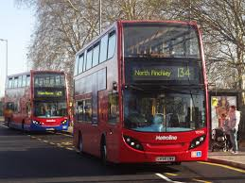
Bus 43 or 134

Slide 6
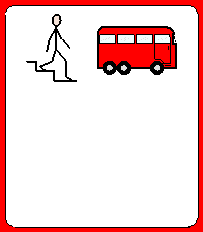
Where do you get off the 43 or 134 bus?

Slide 7
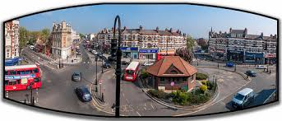
Muswell Hill

Slide 8
What bus do you get from Muswell Hill?

Slide 9
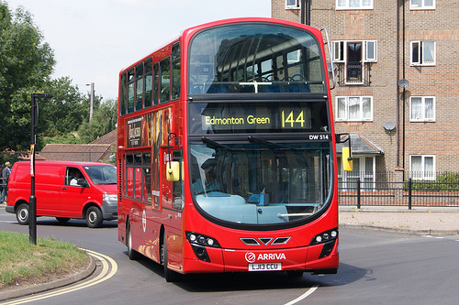
Bus 144

Slide 10
Where do you get off the 144 bus?

Slide 11
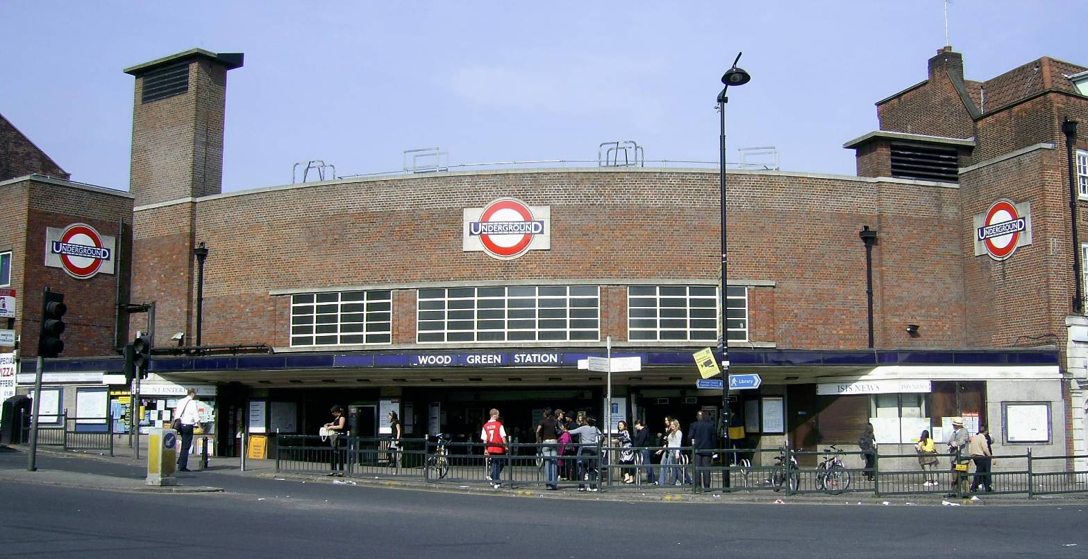
Wood Green.

Slide 12
What’s the number of the bus you get from Wood Green to school?

Slide 13
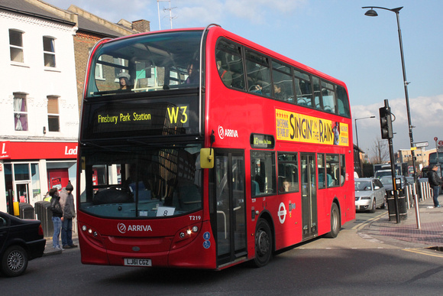
W3 bus

Slide 14
to..

Slide 15
New River Sports Centre stop

Slide 16
New River Sports Centre stop
Perth Road

Slide 17
Who can you ask for help if the bus is diverted and goes to a different place?

Slide 18
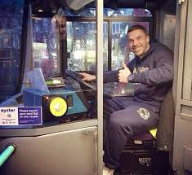
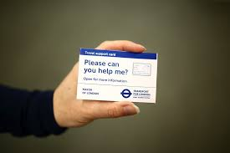
The bus driver and show the driver your Travel Support Card.

Slide 19
Well done and congratulations on becoming an Independent Traveller .

