Slide 1
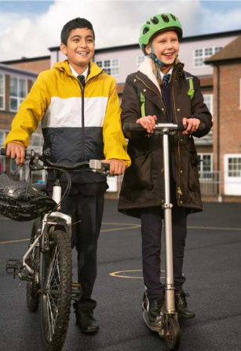
Active Travel Coffee Morning

Slide 2
Our TfL Travel for Life
School Champion is
Place cover image here

Slide 3
Our TfL Explorers Ambassadors/Eco team are...
Place cover image here

Slide 4
We are proud to have achieved:
TfL Travel for Life
Bronze/Silver/Gold Accreditation
and we are going to keep up
our good work!

Slide 5
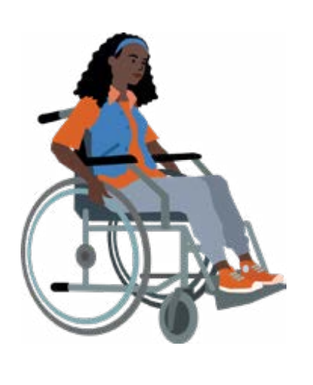
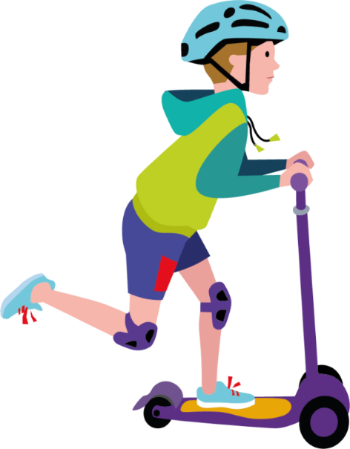
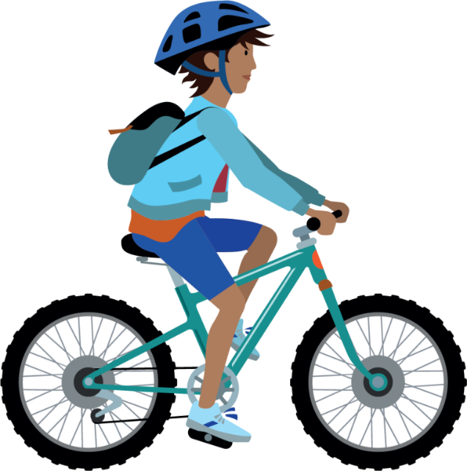
What is Active Travel?
Notes:
What is Active Travel?
It’s using your body to power you to travel – that’s walking, cycling, scooting or wheeling.

Slide 6
Why do we encourage Active Travel?
Students learn better if they have an active start to the day!
Children need to be active!
Young lungs need cleaner air
Streets congested with cars are more dangerous
Cars aren’t always quicker, more reliable or cleaner

Slide 7
Why do we encourage Active Travel?
Students learn better if they have an active start to the day!
Research shows us that even a ten minute walk means students are able to settle better and learn well in the classroom than if they don’t have that active start.
It’s a great way to set them up for the day!

Slide 8
Why do we encourage Active Travel?
Children need to be active! The NHS recommends 60 minutes a day
Walking cycling scooting or wheeling is a great way to sneak in quite a lot of activity.
10 minutes each way and your one third of the way there! Embed the habit while they are young.

Slide 9
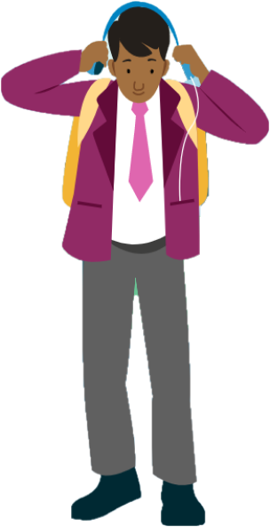
Why do we encourage Active Travel?
Young lungs need cleaner air
Currently, all London schools are in breach of the World Health Organization's air quality limits. 24% of play spaces, 67% of private parks and 27% of public parks exceeded the EU limit for NO2.
This can leave children vulnerable to respiratory diseases, poor lung and brain health, behavioural problems, and increased risk of cancer.
Notes:
From Global Action Plan
https://www.globalactionplan.org.uk/news/simple-actions-can-cut-air-pollution-in-schools-by-over-half-say-experts

Slide 10
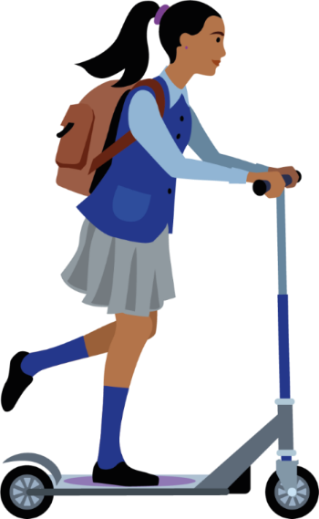
Why do we encourage Active Travel?
Streets congested with cars are more dangerous
It’s harder to find a safe place to cross if cars are parked everywhere
It’s harder to see if it’s clear to cross
Drivers get frustrated and may rush or drive more aggressively
Notes:
The School Streets initiative, which stops people driving past schools at the start and end of school days, reduced particle concentrations by up to 36%.

Slide 11
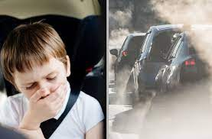
Why do we encourage Active Travel?
Cars aren’t always quicker, more reliable or cleaner
The levels of air pollution drivers experience while stuck in traffic jams is 140% worse than it is for pedestrians outside — and is equivalent to passively smoking a couple of cigarettes.
Congestion means journeys can be disrupted and stressful, and not always quicker
Notes:
From Global Action Plan
https://www.globalactionplan.org.uk/news/simple-actions-can-cut-air-pollution-in-schools-by-over-half-say-experts

Slide 12
What can parents do?

Slide 13
We want to improve the air in our playground
Sometimes the walk home gives me time to myself to think about my day
What do children think?
In most schools taking part in TfL Travel for Life, more children would prefer to walk cycle scoot or wheel than take the car!
I really love scooting and cycling!
I like chatting to my friends or my parents on the walk to and from school
Notes:
From Global Action Plan
https://www.globalactionplan.org.uk/news/simple-actions-can-cut-air-pollution-in-schools-by-over-half-say-experts

Slide 14
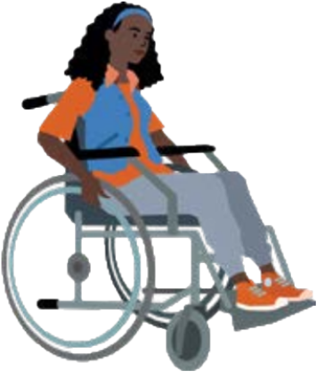
Walking ideas!
Walk to school – it can be a chance to talk and listen
Children can walk with another family, and build friendships
Walk just once a week – it all counts
Can your school start a Walking Bus?
Get a pedometer and have fun tracking your steps together
Notes:
From Global Action Plan
https://www.globalactionplan.org.uk/news/simple-actions-can-cut-air-pollution-in-schools-by-over-half-say-experts

Slide 15
Cycling suggestions
Does your Borough offer family cycle training?
Don’t forget – DR ABC!
Use journey planning apps to plot a quiet safe route
Practise in safer areas
Cycling is a skill for an active life into adulthood
Notes:
From Global Action Plan
https://www.globalactionplan.org.uk/news/simple-actions-can-cut-air-pollution-in-schools-by-over-half-say-experts

Slide 16
Scooting advantages
Great for little legs on longer distances
Great for balance and gross motor skills
Fun!
Talk to the school about scooter parking options
Notes:
From Global Action Plan
https://www.globalactionplan.org.uk/news/simple-actions-can-cut-air-pollution-in-schools-by-over-half-say-experts

Slide 17
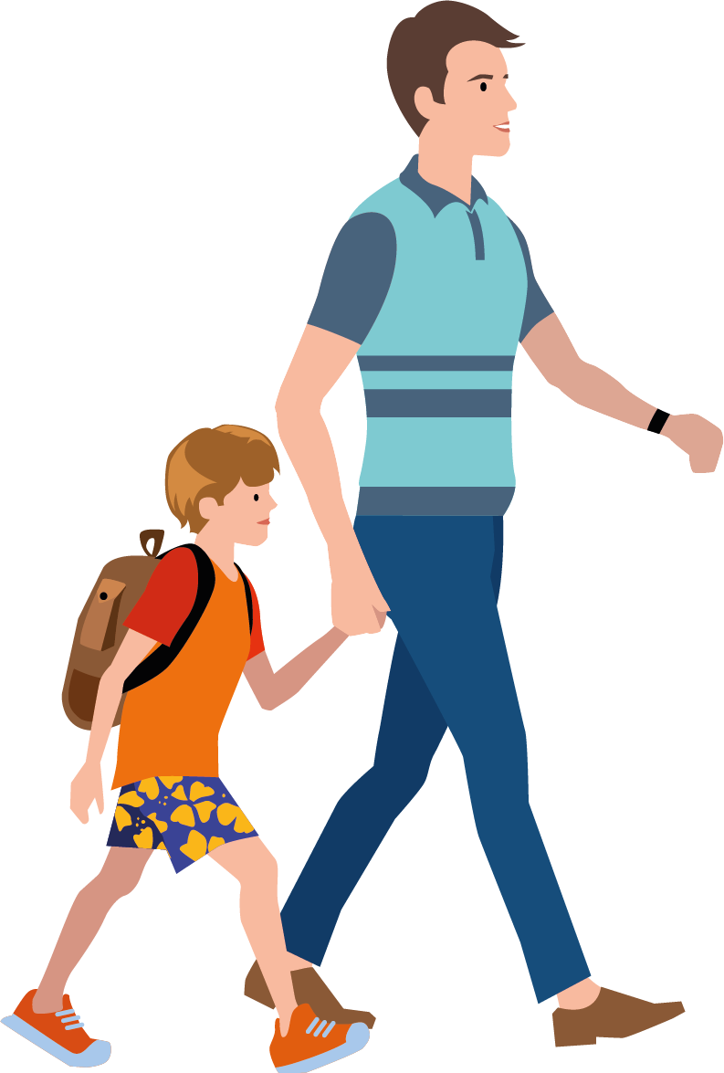
Park and Stride
Park further away and walk the last ten minutes
Prevents pollution around your school playground
Keeps the roads safer around your school
Could even save you a bit of time and be reliable
10 minutes makes a huge difference to you and the children!
Has your school got a walking only zone?
It might be a lot easier to park a bit further away
Notes:
From Global Action Plan
https://www.globalactionplan.org.uk/news/simple-actions-can-cut-air-pollution-in-schools-by-over-half-say-experts

Slide 18
Catch the bus or tram
Learn valuable skills in preparation for independence
Free for children with a Zip Oystercard!
Teach them how to recognise staff who can help them
Build their experience of travelling on the bus
Get them ready for independence and
travelling to secondary school
Notes:
From Global Action Plan
https://www.globalactionplan.org.uk/news/simple-actions-can-cut-air-pollution-in-schools-by-over-half-say-experts

Slide 19
Thank you for listening

