Slide 1
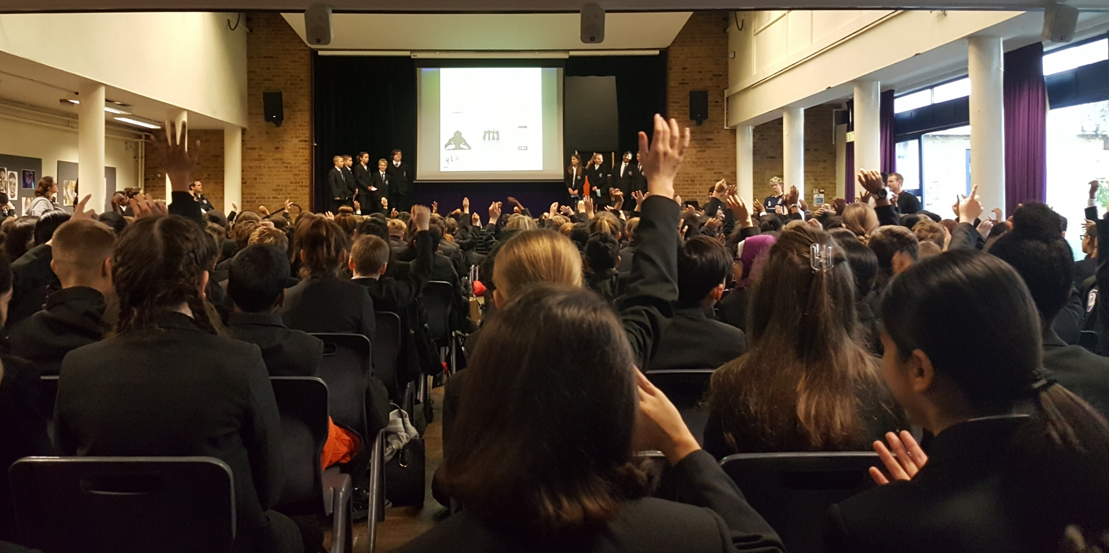
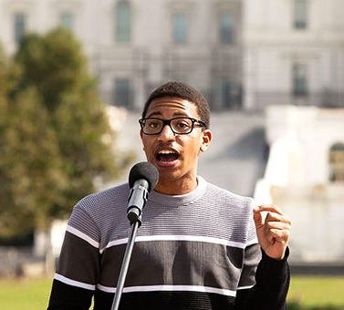
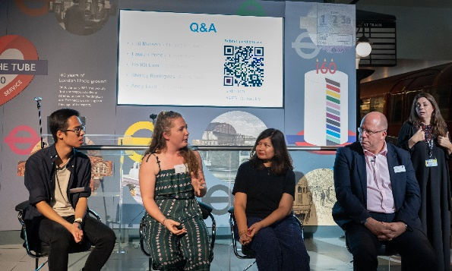
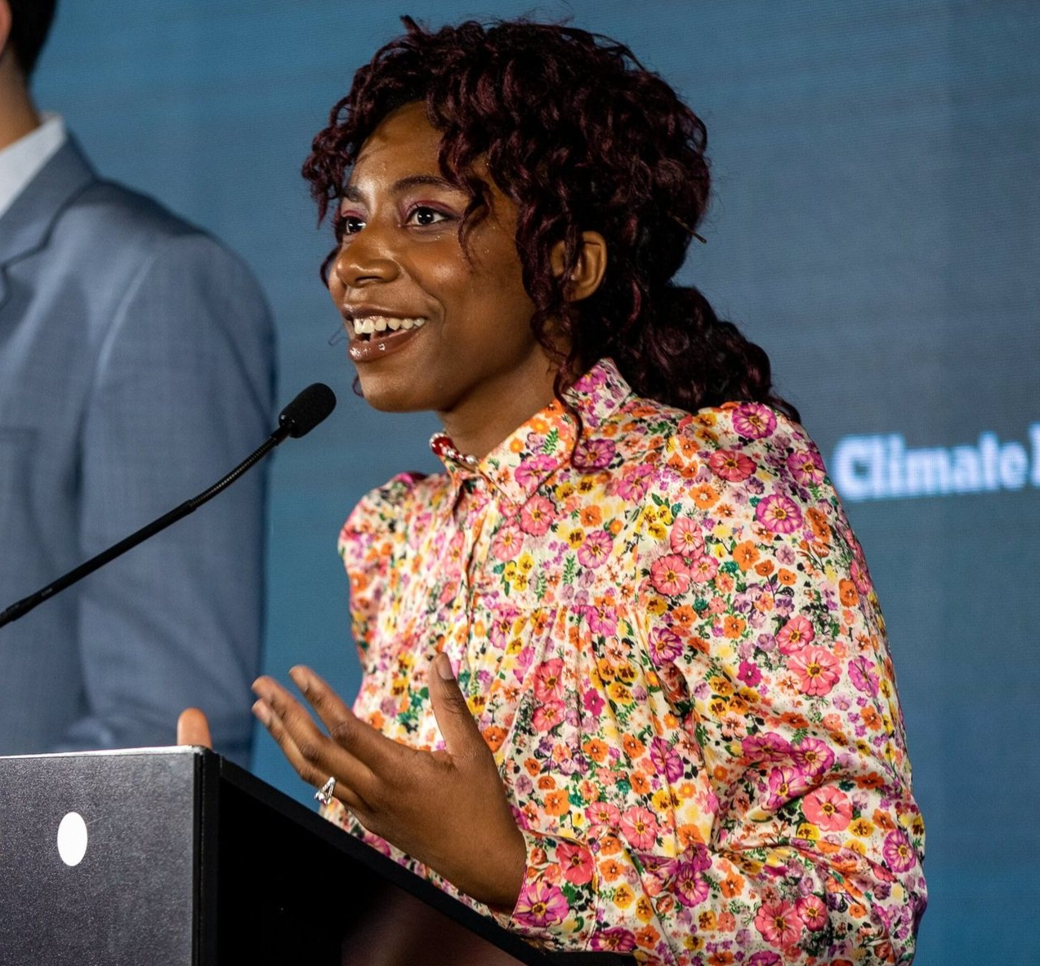
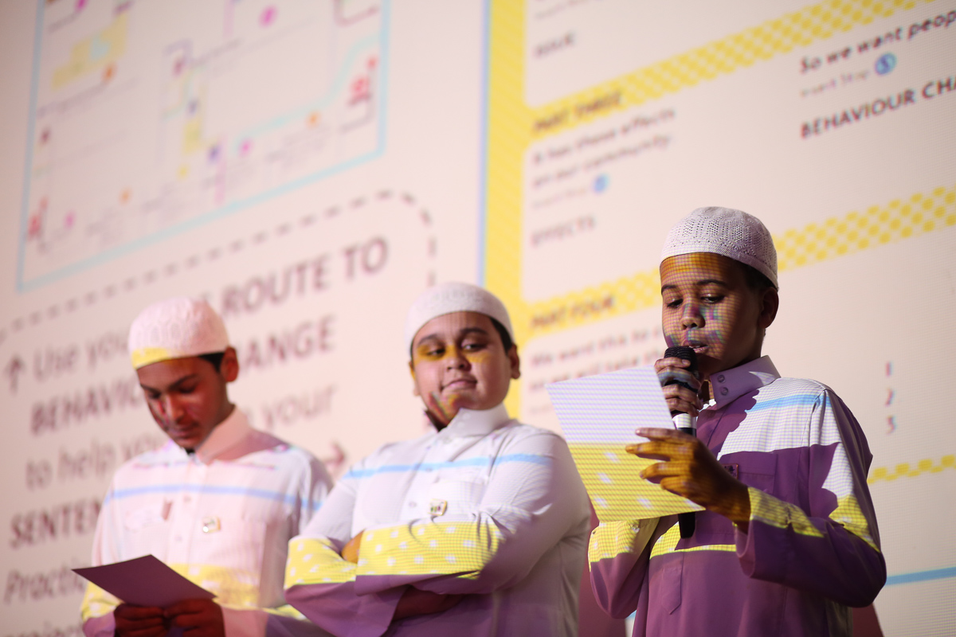
Voices for change
Notes:
Introduce the theme to pupils:
Young people have the power to make their voices heard and to make a real difference to the world! Whether presenting an assembly, video or podcast, there are many ways to get their message out there!

Slide 2
Voices for change
Discover the skills and qualities of a good presenter
Learn and practice techniques for an entertaining presentation
Prepare an inspiring speech to promote your project
Notes:
Explain the objectives to your pupils

Slide 3
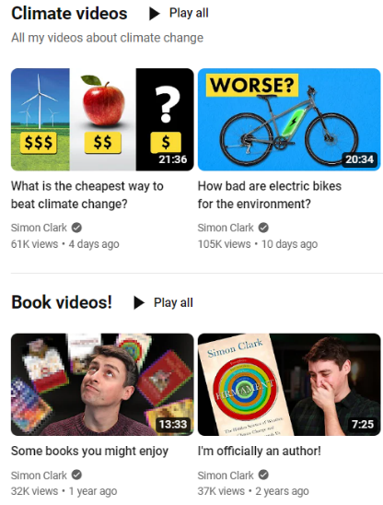
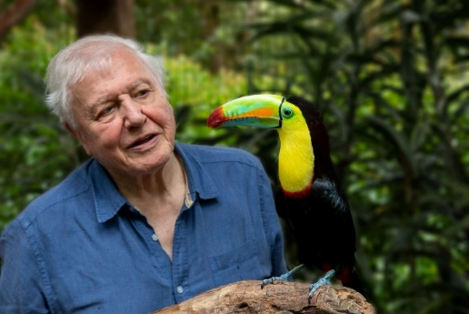
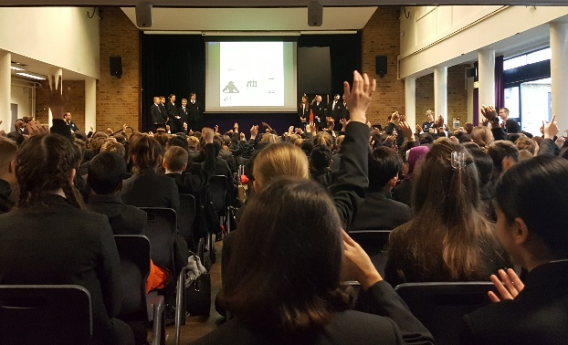
What is the purpose of a presentation?
Think of some presenters you admire.
They could be from TV, YouTube or social media.
What makes you want to watch and listen to them?
Notes:
Put the questions to the group: Think > Pair > Share
What is the purpose of a presentation?
Suggested answers: To inform, to inspire, to persuade, to entertain

Slide 4
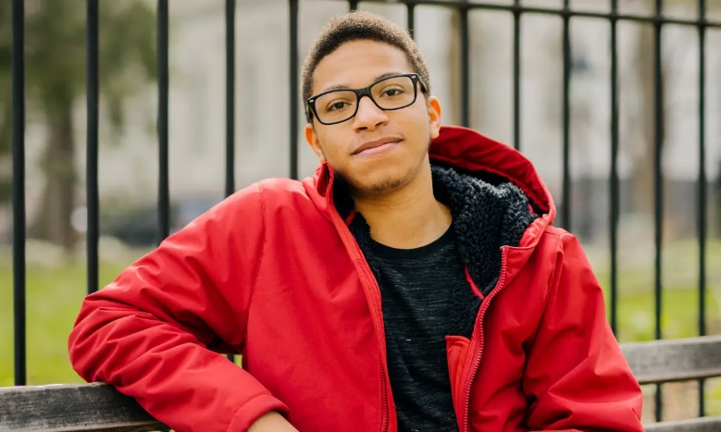
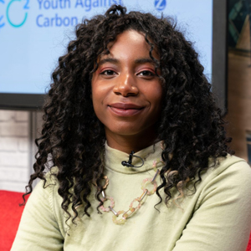
Youth Climate Leaders
Jerome Foster II
Environmental Activist and White House Advisor
Dominique Palmer
Climate Justice Activist and Writer
What do you notice about each presenter’s technique?
What do they do well?
Notes:
Watch the 2 examples of presenting (hyperlinks on photos) and ask pupils the questions to share their thoughts.
Background info on the presenters:
Jerome Foster II is an African-American climate activist, social entrepreneur, and renowned public speaker. Jerome is one of the major organizers of the Fridays for Future and has been a leading voice for Black visibility in climate activism. In March of 2021, Jerome made history becoming the youngest-ever White House Advisor, as he was appointed to the White House Environmental Justice Advisory Council following 80 weeks of holding weekly climate strikes in front of the White House and leading the OneMillionOfUs initiative registering one million young people to vote. He is the co-founder and Executive Director of Waic Up, a climate justice advocacy non-profit organization using art, journalism, and civic engagement to impact positive change.
Dominique Palmer FRSA (born 7 October 1999) is a British climate justice activist and student.She spoke at 2019 United Nations Climate Change Conference, and began her activism as one of the U.K’s leading U.K environmentalists and youth activists in the School Strike for Climate Movement.

Slide 5
What is important about each thing?
Voice
Body Language
Gestures
How can these things help our presentations?
Notes:
Put the questions to the group: Think > Pair > Share

Slide 6
Bringing a text to life!
How could you use your voice or movement to emphasise these words?
Which words are most important?
Dreams are free
Goals have a cost
While you can daydream for free
Goals don’t come without a price
Time, effort, sacrifice and sweat
How will you pay for your goals?
Usain Bolt
Jamaican sprinter and World Record Holder
Notes:
Ask pupils to select words they think need extra emphasis – which words do they think are most important? How could they use their voice or their movement to emphasise these words?
Ask them to demonstrate any movements or gestures that could enhance the words and/or provide your own examples. Using British Sign Language can add an extra layer of meaning to your speech and can help to make your speech accessible to a wider audience. See the BSL video dictionary for ideas: https://www.signbsl.com/

Slide 7
Pausing and Emphasising
Why Pause?
How can we emphasize?
Both bring your text to life...!
It gives the listener time to understand and process
the information!
With a change in volume, speed or tone of voice
By adding a gesture or movement
More memorable, entertaining and fun
to listen to!
Notes:
Put the questions to the group: Think > Pair > Share > Reveal answers

Slide 8
Philosopher Quotes
Primary schools
Speech 1
“The Journey of a thousand miles begins with a single step”.
LAO TZU (Chinese Philosopher)
Speech 3
“All truly great thoughts
are conceived while walking”.
FREDERICK NIETZSCHE (German Philosopher)
Your Task
ADD
PAUSES
Speech 2
“Life is like riding a bicycle.
To keep your balance,
you must keep moving”.
ALBERT EINSTEIN (Scientist)
Speech 4
“Great leaders don't set out to be a leader. They set out to make a difference. It is never about the role - always about the goal”.
LISA HAISHA (Life coach and TV producer)
UNDERLINE
ADD
MOVEMENT
Notes:
Give pupils a printed copy of one of the speeches:
You will receive one of these 4 quotes. Working in pairs, your task is to bring your speech to life!
Mark your quote with a forward slash for a pause and underline any words or phrase to give extra emphasis. Then practice reading it aloud.
Who do you think gave this quote – a politician, a TV presenter, an athlete...?

Slide 9
Climate Leader Quotes
Secondary schools
Speech 5
“The Climate Crisis is both the easiest and the hardest issue we have ever faced. The easiest because we know what we must do: stop emissions of greenhouse gases.
The hardest because we are still dependant on fossil fuels”.
Speech 6
“It seems to me the natural world is the greatest source of excitement, the greatest source of visual beauty, the greatest source of intellectual interest. It is the greatest source of so much in life, that it makes life worth living”.
Your Task
ADD
PAUSES
Speech 7
“The race to safeguard the future of the planet has begun and so we must act now. We are not only fighting for our futures but those already suffering. We need ambitious change that places people and the planet at the heart”.
Speech 8
“Young people have always been leaders of change. We’ve always been out on the streets. We’ve always been pushing the envelope because we want our future to be better”.
UNDERLINE
ADD
MOVEMENT
Notes:
Give pupils a printed copy of one of the speeches:
You will receive one of these 4 quotes. Working in pairs, your task is to bring your speech to life!
Mark your quote with a forward slash for a pause and underline any words or phrase to give extra emphasis. Then practice reading it aloud.
Who do you think gave this quote – a politician, a TV presenter, an athlete...?

Slide 10
For a great presentation, remember...
Pausing
Emphasising
Movement
Performance
Notes:
Read summary and ask pupils which techniques they think are most effective and why

Slide 11
Use these techniques to bring your presentations and assemblies to life!
Why not use one of the speeches in an assembly?
Earth Day
World Environment Day
Walk to School Week
Clean Air Day
Have fun presenting!

